Slide 1


Welcome…
a few things to note before we begin:
Grab a handout
We are having a Post-Secondary
Fair on Nov 3rd →
If you are an SHSM students, attending this session counts as a Reach Ahead (you will need to self-report using the Google Form
on the Google Classroom
This will be shared on the Maple Grads Google Classroom

Slide 2
Applying to
Ontario’s Universities
101 Application for
Ontario High School Students
www.ouac.on.ca/ouac-101

Slide 3
Step 1:
Get Your OUAC Access Codes
Your access codes include a:
Temporary PIN
School Number
Student Number
These codes allow you
to access your 101 application.
Your PIN is confidential!
Don’t share it with anyone else.
Notes:
The Personal Identification Number (PIN), in conjunction with the school number (MIDENT) and the student number (SSSN), allows each student to log in and access their personal 101 account. Students should not share their PINs with anyone!
We (the OUAC) will generate a PIN for each student once we receive their electronic school records. If any students lose their access codes, their guidance counsellors can print their Access Code Letter from the PIN Checklist in the “PINs” option of Counsellors’ Online Services (COLS).

Slide 4
Step 2:
Research Your University Options
      Visit OUInfo (www.ontariouniversitiesinfo.ca) to see what each university has to offer.
      Read the 101 Application Guide (available at www.ouac.on.ca/guide/101-guide) for up-to-date information about universities and their programs.
      Check out university publications and websites.
      Talk to counsellors, family, teachers and friends.
      Write down your program choices and codes and keep them handy.
Notes:
We encourage students to research their university options prior to logging in to the 101 application. We recommend that students make a list of their program codes and keep it handy when they log in. This greatly reduces the time required to complete the application.

Slide 5
Step 3: Mark Your Calendar
      October/November 2022: Receive your access codes for the 101 application.
      January 12, 2023: Deadline to submit your completed application to the OUAC.
      May 29, 2023: Last day you can expect a response from an Ontario university if you applied by the January 12th deadline.
      June 1, 2023: The earliest day you may be required to respond to an offer and give a financial commitment (e.g., registration or residence deposit, etc.).
Notes:
These dates are established by guidance counsellors, the Ontario universities and the OUAC. Individual high schools may have additional internal deadline dates.
Students should not wait until the last minute to submit their applications – internet connections may be interrupted as the deadline date approaches. January 12, 2023, is the application deadline. We will accept applications after this date, but certain limited enrollment programs may no longer be available.

Slide 6

Step 4: Apply!
Access the application at: www.ouac.on.ca.
Notes:
Students will access the 101 application at: www.ouac.on.ca.

Slide 7
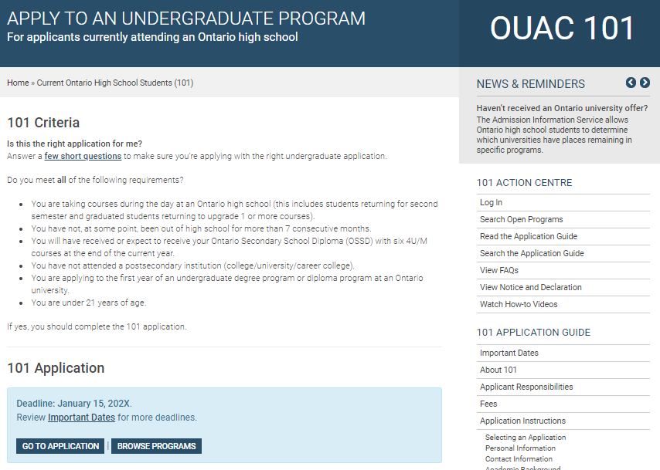
Let’s Get Started!
Access the application at: www.ouac.on.ca/ouac-101.
Notes:
Ontario high school students have their own page on the OUAC website that includes all the links related to the application process: www.ouac.on.ca/ouac-101.

Slide 8
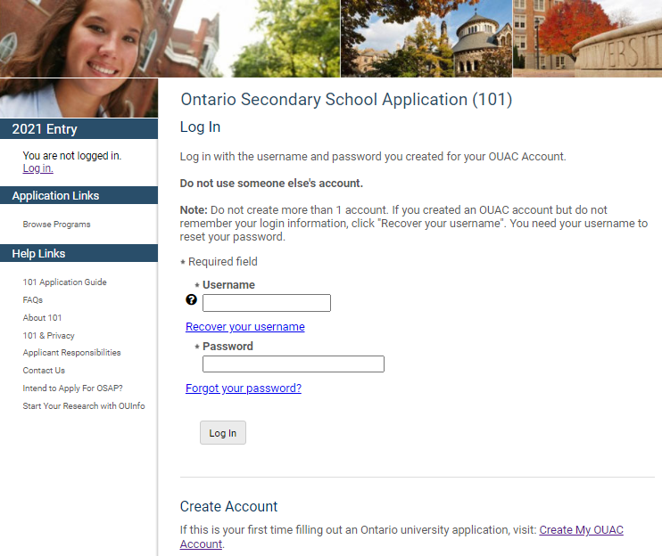
Creating an Account For the First Time
The first time you log in you will need to create an OUAC account.
Notes:
While students can browse programs through the “Browse Programs” link without logging in to the application, they must log in to access personalized applicant data and prepare their application. When logging in for the first time, students must create an OUAC account.

Slide 9
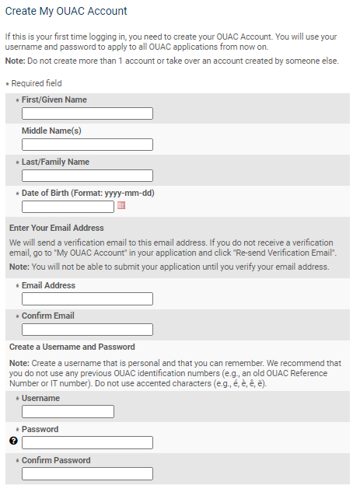
Your OUAC Account
Create Your Username and Password
Create a username that is easy for you to remember. You will use it to apply to all OUAC applications from now on.
Notes:
Students fill in basic personal information and create a username and password. They should create a username that is personal and easy for them to remember as they will be using it to log in to their application from now on and to apply to all future OUAC applications.

Slide 10
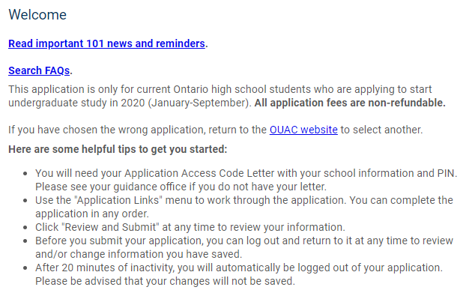
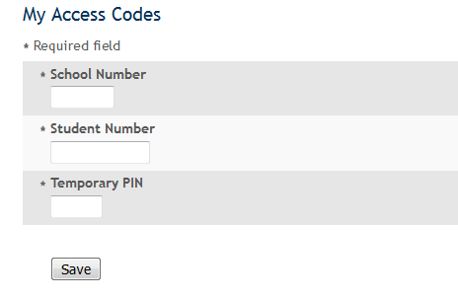
Welcome Page and Access Codes
Review the helpful tips on the Welcome page and enter the access codes provided by your school to start your application.
2023
Notes:
When logging in to their application for the first time, students must use their confidential access codes.
It is important to enter the access codes exactly as they are provided and to keep them confidential.
The student’s OUAC account is their own personal storage space on the OUAC website. Students may return to the account at any time to review and/or change saved information prior to submitting their application.

Slide 11
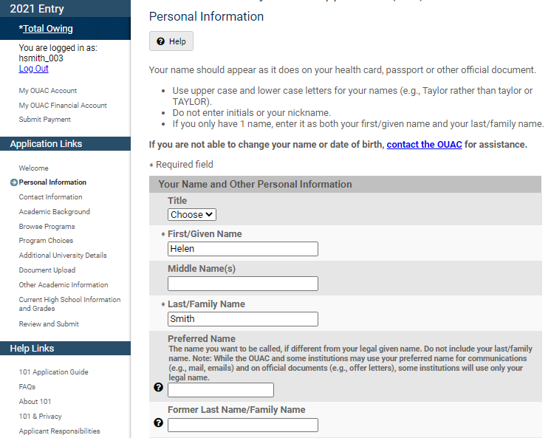
Navigating the 101 Application
Help links are located on most of the application screens or on the fields themselves.
Notes:
The main navigation bar appears on the left side of each screen throughout the application to guide students through the process.

Slide 12
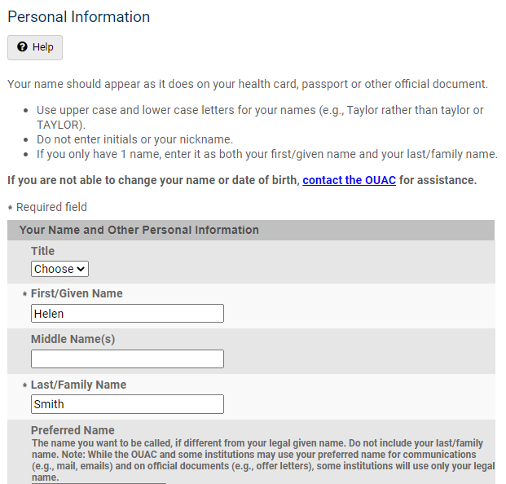
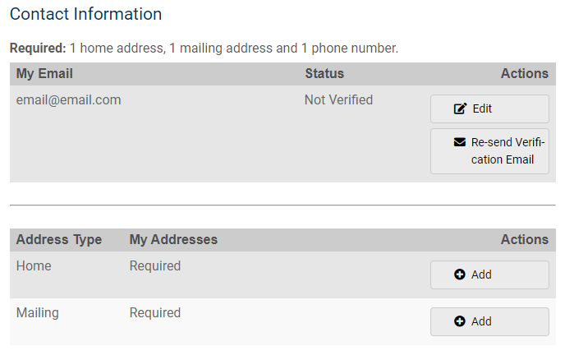
Add Personal and Contact Info
Notes:
Ensure that all information in the Personal Information and Contact Information sections is accurate and complete. The student must make additions and corrections as necessary. For example, it is important that the student provides all legal given names. Students should not use nicknames, abbreviations or initials.
Students must enter email addresses accurately, as the OUAC and the universities correspond with students via email during the application process. When the student creates their OUAC account, they will receive an email asking them to click a link to verify their email address. They are not able to submit their application until they verify their email address. If they lose the email, they can re-send it to themselves through the Contact Information section in their application.

Slide 13
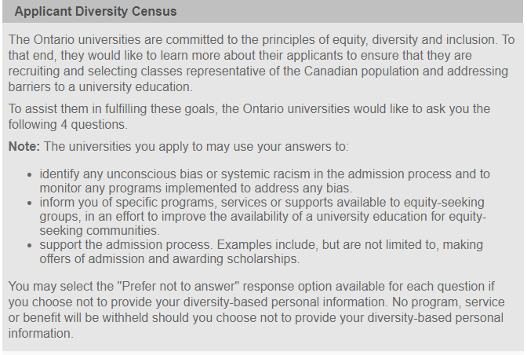
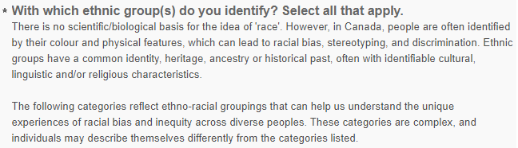

Applicant Diversity Census
There is now an ‘Applicant Diversity Census’ within the Personal Information section of the application. More information about the census can be found here.

Slide 14
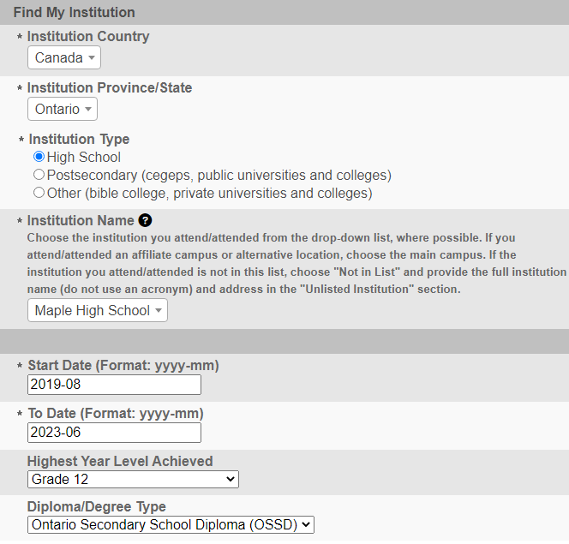
Academic Background
For OSSD students - You do not need to complete this section. Sometimes additions to this section causes an application error
For IB students - You will need to complete this section to show that you will be completing both the OSSD and IB Diploma (see Other Academic Information on slide 22)

Slide 15
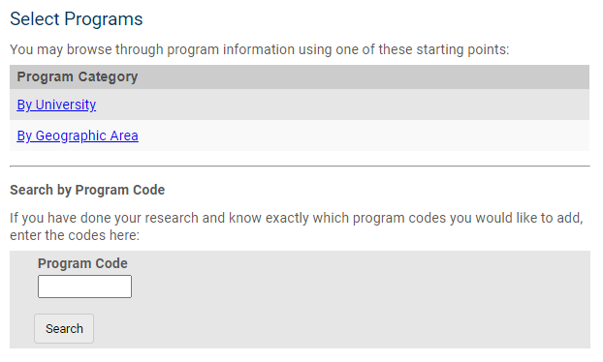
Select Your Programs
You can search for programs by category or by entering a program code.
Notes:
If students know the program codes of the programs they would like to apply to, they can add the program codes 1 at a time using the “Search by Program Code” option.
Or students can explore using the “Program Category” options.

Slide 16
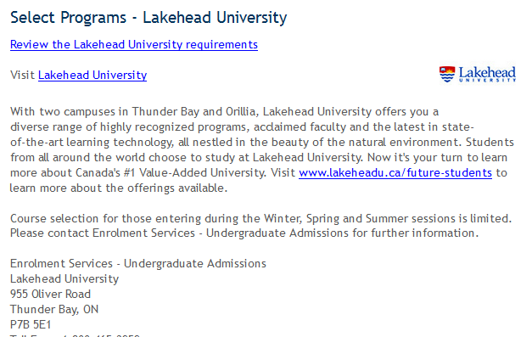
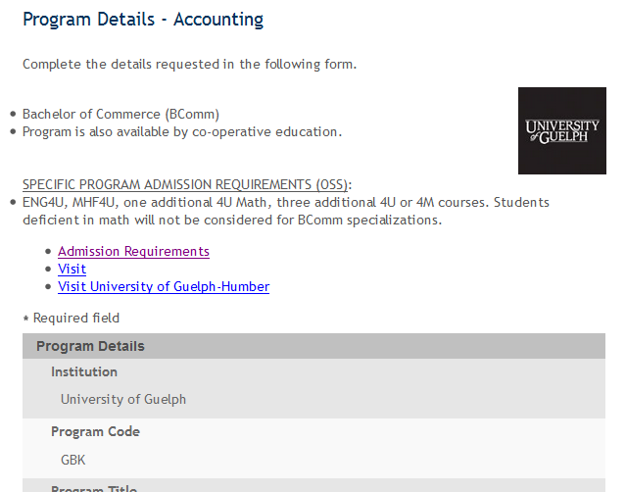
After You Have Selected a Program
Complete the program details for each program selected.
View the admission requirements for the program
Notes:
Near the top of this screen, students can view and confirm the admission requirements for the selected program.
Then, for each program chosen, they must complete the Program Details screen. This includes indicating the "Subject of Major Interest" (if applicable), co-op options (if available) and details about their anticipated start term. They can then add their program choices and details to their application.
Students may apply to as many Ontario universities/programs as they wish; however, they are limited to a maximum of 3 program choices at any 1 university (including the university’s affiliates). Some universities may further limit the number of programs candidates may apply to.

Slide 17
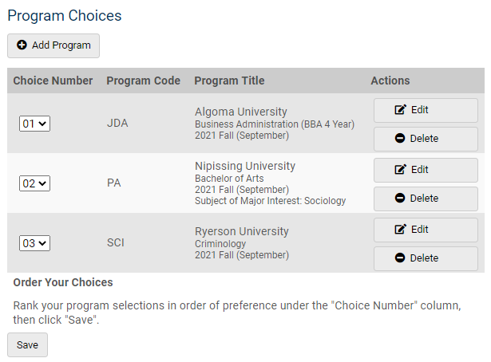
Order Your Choices
The choice order does not affect scholarship or admission consideration unless a university’s information specifically states that it does.
Notes:
Number program choices in order of preference. Numbering does not affect scholarship or admission consideration unless a university specifically states this in its information. By default, program choices initially appear in the order that the student selected them.

Slide 18
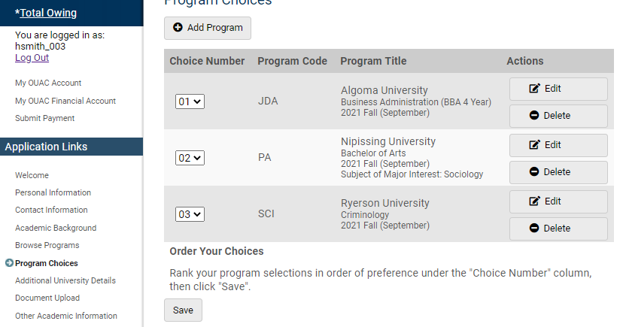
Fees
The cost is $150 for the first 3 university/program choices and $50 for each additional choice.
Notes:
The cost is $150 for the first 3 university/program choices and $50 for each additional choice.
Students can see their fees in real time by clicking “Total Owing”.

Slide 19
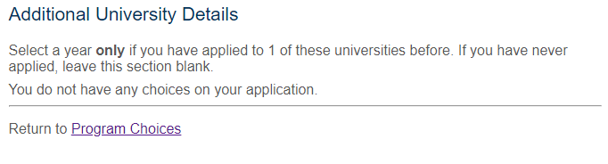
Additional University Details
This section only applies to you if you have applied to university before.
Since you have not, move on to the next section.

Slide 20
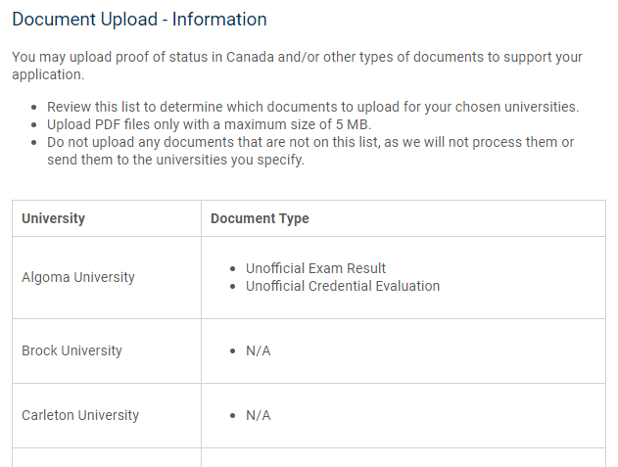
Document Upload
You can upload documents that support your application, as required by your university choices.
Notes:
Students can upload documents confirming proof of status in Canada and English-language test results, for example.

Slide 21

Document Upload - Information
This section is NOT MANDATORY. If an institution requires documentation they will request it directly from you via email or their registration platform.

Slide 22
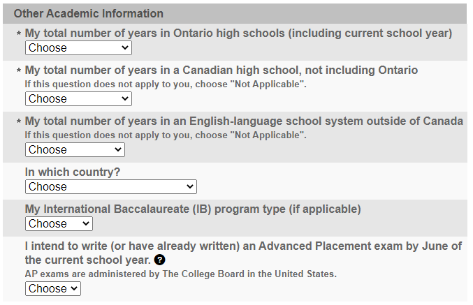
Other Academic Information
Answer the questions and click ‘Save’
IB Students - This is where you will indicate your IB Program Type (Diploma)

Slide 23
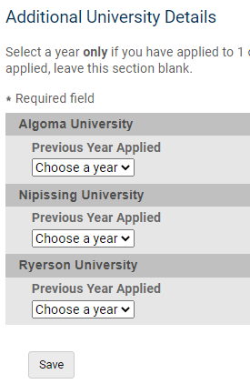
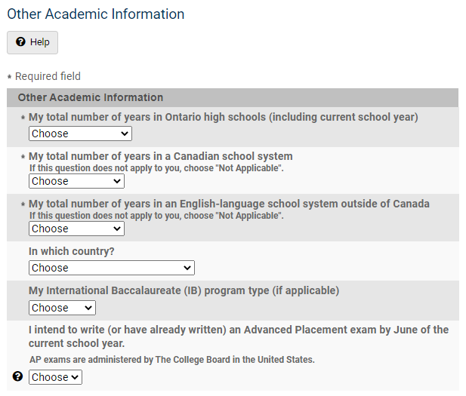
Answer Questions
You must complete the Additional University Details and Other Academic Information sections.
Notes:
If a student previously applied to any of their university choices, they must indicate this in Additional University Details. Students provide general information about their educational background in Other Academic Information.

Slide 24
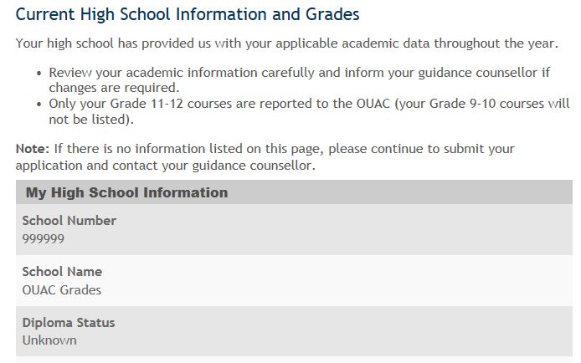
Current High School Info/Grades
Please monitor and report errors to your guidance counsellor.
This screen is read-only.
Notes:
It is the student’s responsibility to check the Current High School Information and Grades page carefully and to report any errors to the guidance office.
This page is read-only, which means that students cannot alter this data. The student should, however, check the information carefully for any errors or omissions. If there are errors, they should continue to prepare and submit the application, and then notify the guidance office as soon as possible.
If no academic data is recorded, the student can first complete and then submit the application. School officials who have access to “Academic Updates” in COLS may log in and update the student’s academic data.
Counsellors may encounter this situation for students they manually created a PIN for using COLS.

Slide 25
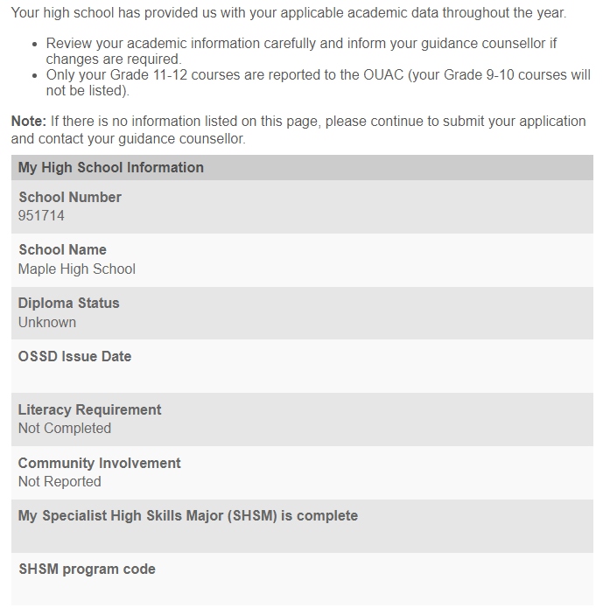
Current High School Information & Grades
Check Current High School Information/
Grades - report any errors to your Guidance Counsellor
This screen is read-only.

Slide 26
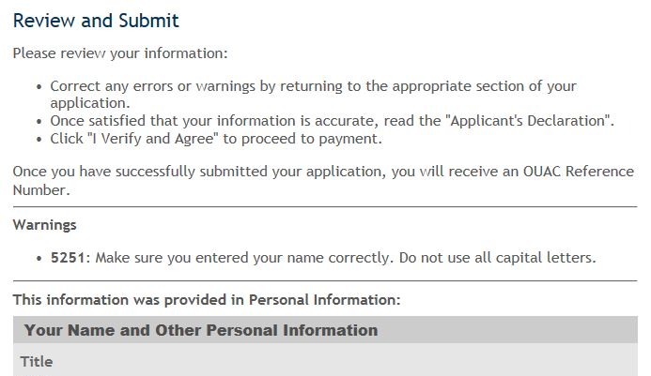

Submitting Your Application
Click to proceed to the payment screen.
Notes:
Once they have added all information to the application, the student should click “Review and Submit”. All the information the student entered earlier in the application process will be presented on 1 page for verification. Students should print this page for their records.
To proceed to the Payment screen, the student must read the Applicant’s Declaration and click “I Verify and Agree” at the bottom of the screen. After they click “I Verify and Agree”, they will not be able to edit their application.

Slide 27
Paying for Your Application (1 of 2)
You can pay by the following methods:
VISA, MasterCard, American Express, VISA Debit or Debit MasterCard:
You will need the card number, expiry date and CVV/CVC/CID number.
Online Banking:
You will receive a bill payment account number from the OUAC when you submit your application.
Flywire:
For international payments only. You can pay the Canadian dollar fees in the currency of your choice.
Notes:
Online Banking: Students must already be registered for online banking through their bank. The OUAC accepts payment from selected Canadian banks only. Students should contact their bank for further details.

Slide 28
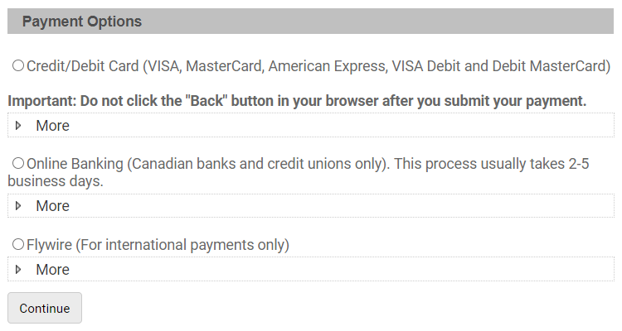
Paying for Your Application (2 of 2)
Once you choose your method of payment and click “Continue”, you will receive your OUAC Reference Number.
The OUAC cannot process your application without the application fee.
Notes:
To fully submit their application, the student must choose a method of payment and click the “Continue” button at the bottom of the payment screen.
We accept credit/debit card (VISA, MasterCard, American Express, VISA Debit or Debit MasterCard) for application fee payments. The student should review their credit/debit card number and expiry date carefully before they submit payment. We will email credit/debit card receipts immediately.
If the student chooses to pay using online banking, we will provide a bill payment account number once the student submits the completed application. The student will require this bill payment account number to submit their payment. The OUAC’s bill payment name is “Ontario Universities’ Application Centre” (or an abbreviated version of this name). We will not process or distribute applications until we receive the application processing fee and any applicable additional fees. The student must make all payments at the same time they submit their application.

Slide 29
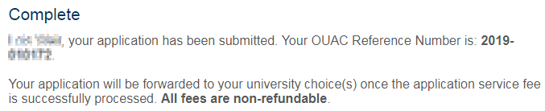
Finishing
On the Complete page, print the screen displaying your OUAC Reference Number (2023-XXXXXX) and instructions. You will also receive an email.
Record your OUAC Reference Number, as you will need to include it when communicating with the OUAC and the universities.
Notes:
Immediately after they submit their completed application, the student's OUAC Reference Number and instructions will be displayed on-screen. Students should print this screen and cite their OUAC Reference Number whenever they communicate with the OUAC or the universities.
Students can view and/or make changes to their submitted 101 application by logging in to their application account at: www.ouac.on.ca/ouac-101. The ability to view and/or make changes will be available approximately 1 business day after the application is submitted and the application fee payment is received and processed.

Slide 30
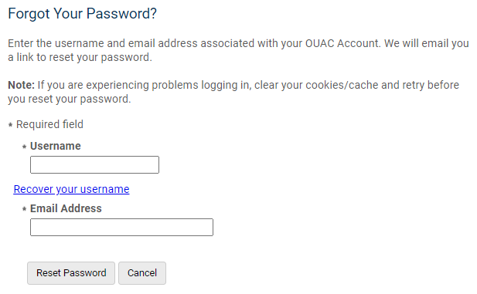
Reset Your Password
Notes:
If a student forgets their OUAC account password, they can request a temporary password by clicking “Forgot your password?” on the Log In page. Students must enter their OUAC account username and email address. A link to reset their password will be emailed to them immediately. Note that the link will expire 1 hour from the time sent.

Slide 31

Thank you…As always, Please feel free to book a guidance appointment via TeachAssist.

Slide 32
Need Assistance?
Read the FAQ section and the 101 Application Guide on our website at: www.ouac.on.ca/faq-application/101.
Contact us:
OUAC
170 Research Lane
Guelph ON N1G 5E2
Telephone: 519-823-1063
Fax: 519-823-5232
Email: 101sup@ouac.on.ca
Website: www.ouac.on.ca/ouac-101
Notes:
Help with the application is available in several places, including the FAQs section on our website, the Help screens within the application and Applicant Services. Students should also refer to the 101 Application Guide available online for university program code information and other details.
They should also visit OUInfo at: www.ontariouniversitiesinfo.ca.

Slide 33
Video Tutorials

Slide 34
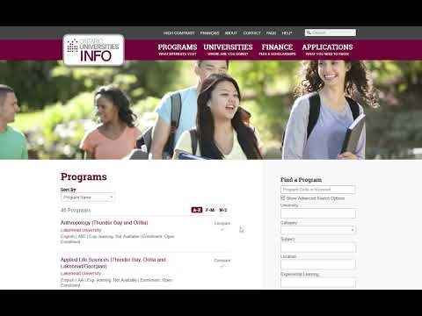
How to Use OUInfo: Your Starting Point for Researching Ontario’s Universities
This video explores the OUInfo website – a searchable resource that provides up-to-date information about:
Ontario universities,
programs,
scholarships,
residences,
campus tours and events and
more.

Slide 35
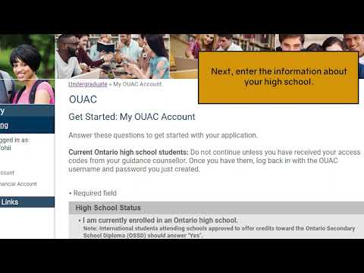
How to create your OUAC (video)
This video explains how to create an OUAC account and start your 101 application.

Slide 36
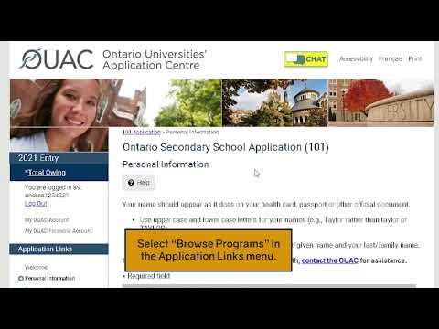
How to browse and add programs to your application (video)
This video explains how to search for programs and add, delete or edit program choices in your 101 application.

Slide 37
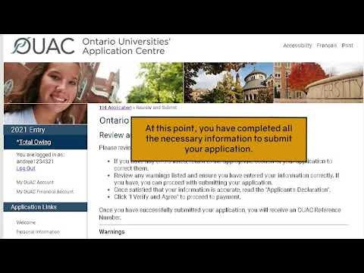
How to complete your application (video)
This video explains how to prepare, review, submit and pay for your 101 application.

Slide 38
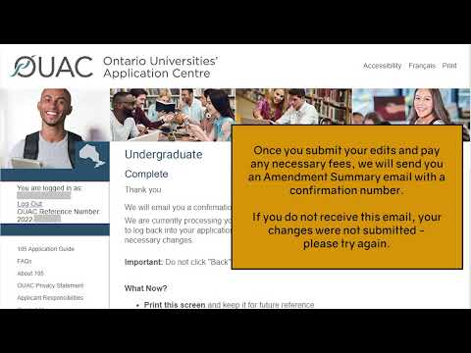
How to edit your completed application (video)
This video explains how to review and edit your application after you submit it, including adding and withdrawing programs.

Slide 39
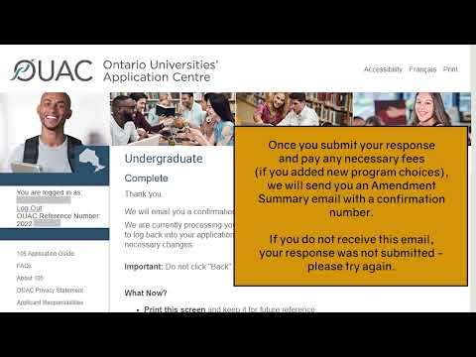
How to respond to an Ontario University offer of admission (video)
This video explains how to check for university offers of admission and how to accept or decline those offers.

